Slide 1
What is Cloud Computing?
Cloud computing is an umbrella term used to refer to Internet based development and services.
A number of characteristics define cloud data, applications services and infrastructure:
A. Services or data are hosted on remote infrastructure.
B. Services or data are available from anywhere.
C. The result is a utility computing model similar to traditional that of traditional utilities, like gas and electricity - you pay for what you would want!

Slide 2
What is Cloud Computing?
Example:
Many companies are delivering services from the cloud.
Some notable examples include the following:
' Google — Has a private cloud that it uses for delivering Google Docs and many other services to its users, including email access, document applications, text translations, maps, web analytics, and much more. '
Microsoft — Has Microsoft@ Office 365 online service that allows for content and business intelligence tools to be moved into the cloud, and Microsoft currently makes its office applications available in a cloud. '
Salesforce.com — Runs its application set for its customers in a cloud, and its Force.com and Vmforce.com products provide developers with platforms to build customized cloud services.

Slide 3
Deployment Models in Cloud Computing
Deployment models define the type of access to the cloud, i.e., how the cloud is located?
Cloud can have any of the four types of access: Public, Private, Hybrid and Community.

Slide 4
Deployment Models
The Public Cloud allows systems and services to be easily accessible to the general public.
Public cloud may be less secure because of its openness
e.g., e-mail.
PRIVATE CLOUD : The Private Cloud allows systems and services to be accessible within an organization.
It offers increased security because of its private nature.
COMMUNITY CLOUD : The Community Cloud allows systems and services to be accessible by group of organizations.
HYBRID CLOUD : The Hybrid Cloud is mixture of public and private cloud.
However, the critical activities are performed using private cloud while the non- critical activities are performed using public cloud.

Slide 5
Service Models
Service Models are the reference models on which the Cloud Computing is based.
These can be categorized into three basic service models as listed below:
1. Infrastructure as a Service (laaS)
2. Platform as a Service (PaaS)
3. Software as a Service (SaaS)

Slide 6
Service Models
Infrastructure as a Service (laaS)
laaS is the delivery of technology infrastructure as an on demand scalable service.
laaS provides access to fundamental resources such as physical machines, virtual machines, virtual storage, etc.
'Usually billed based on usage 'Usually multi tenant virtualized environment 'Can be coupled with Managed Services for OS and application support.
Best laaS providers of 2019 :
amazon web services , Google Cloud Platform , Microsoft _Azure , IBM Cloud

Slide 7
Service Models
Platform as a Service (PaaS) the runtime environment for applications.
PaaS provides development & deployment tools, etc.
PaaS provides all of the facilities required to support the complete life cycle of building and delivering web applications and services entirely from the Internet.
Typically applications must be developed with a particular platform in mind.
'Multi tenant environments 'Highly scalable multi tier architecture’.
Top Paas Provider 2019 platform :
Salesforce,
AWS Lambda

Slide 8
Service Models
Software as a Service (SaaS) SaaS model allows to use software applications as a service to end users.
SaaS is a software delivery methodology that provides licensed multi-tenant access to software and its functions remotely as a Web-based service.
' Usually billed based on usage Usually multi tenant environment Highly scalable architecture’ .
Top Saas for Company :
Microsoft' s Office 365
salesforce
Google Apps eox

Slide 9
Virtualization Virtual workspaces
An abstraction of an execution environment that can be made dynamically available to authorized clients by using well-defined protocols, Resource quota (e.g. CPU, memory share), Software configuration (e.g. O/S, provided services).
Virtualization in General Advantages of virtual machines:
Run operating systems where the physical hardware is unavailable,
Easier to create new machines,
backup machines, etc.,
Timeshare lightly loaded systems on one host etc.

Slide 10
Opportunities and Challenges
The use of the cloud provides a number of opportunities:
enables services to be used without any understanding of their infrastructure.
Cloud computing works using economies of scale: It potentially lowers the outlay expense for start up companies, as they would no longer need to buy their own software or servers.
Cost would be by on-demand pricing.
Vendors and Service providers claim costs by establishing an ongoing revenue stream.
Data and services are stored remotely but accessible from "anywhere".

Slide 11
Disadvantages of Cloud Computing
Requires a constant Internet connection: Cloud computing is impossible if you cannot connect to the Internet.
Since you use the Internet to connect to both your applications and documents, if you do not have an Internet connection you cannot access anything, even your own documents.
With cloud computing, all your data is stored on the cloud. The questions is How secure is the cloud?
Theoretically, data stored in the cloud is safe, replicated across multiple machines.
But on the off chance that your data goes missing, you have no physical or local backup. Put simply, relying on the cloud puts you at risk if the cloud lets you down.

Slide 12
Virtual Machines
Virtual machines, or VMs, are a hardware virtualization technology that allows you to fully virtualize the hardware and resources of a computer.
A separate guest operating system manages the virtual machine, completely separate from the OS running on the host system.
On the host system, a piece of software called a hypervisor is responsible for starting, stopping, and managing the virtual machines.
VMs are operated as completely distinct computers that, under normal operating conditions, cannot affect the host system or other VMs, virtual machines offer great isolation and security.

Slide 13
Containers
Containers take a different approach.
Rather than virtualizing the entire computer, containers virtualize the operating system directly.
They run as specialized processes managed by the host operating system’s kernel, but with a constrained and heavily manipulated view of the system’s processes, resources, and environment.
Containers are unaware that they exist on a shared system and operate as if they were in full control of the computer.
Rather than treating containers as if they were full computers like with virtual machines, it is more common to manage containers more similarly to applications.

Slide 14
Benefits of Containerization
Lightweight Virtualization
Compared to hardware virtualization with virtual machines, containers are extremely lightweight.
Rather than virtualizing all of the hardware resources and running a completely independent operating system within that environment, containers use the host system’s kernel and run as compartmentalized processes within that OS.
Environmental Isolation
By using Linux kernel features like cgroups and namespaces, containers are isolated from the host environment and each other.
This provides a level of functional confinement to help prevent container environments from interfering with one another.

Slide 15
Benefits of Containerization
Scalability
The container paradigm also allows you to scale your applications using relatively straightforward mechanisms.
Lightweight image sizes, quick start up times, the ability to create, test, and deploy “golden images”, and the standardized runtime environment are all features that can be used to build highly scalable systems.

Slide 16
Container Terminology
Container: In Linux, containers are an operating system virtualization technology used to package applications and their dependencies and run them in isolated environments.
Container Image: Container images are static files that define the file system and behaviour of specific container configurations.
Container images are used as a template to create containers.
Container Orchestration: Container orchestration is a term used to describe the processes and tooling required to manage fleets of containers across multiple hosts.
Container orchestration typically controls scaling, fault tolerance, resource allocation, and scheduling using a container platform.
Container Runtime: A container runtime is the component that actually runs and manages containers on a host.
The minimum requirement is usually to be able to provision a container from a given image.

Slide 17
Container Terminology
Docker: Docker was the first technology to successfully popularize the idea Linux containers.
Docker’s ecosystem of tools includes :
docker, a container runtime with extensive container and image management features
docker-compose, a system for defining and running multi-container applications
Docker Hub, a container image registry.
Dockerfile: A Dockerfile is a text file describing how to build a container image.
It defines the base image, the commands to run within the system, and way that the runtime should start and manage the processes within the container.

Slide 18
Container Terminology
Kubernetes: Kubernetes is a powerful container orchestration platform that manages clusters of container hosts and the workloads that run on them.
Kubernetes offers tooling and abstractions to deploy, scale, monitor, and manage containers in highly available production environments.
Virtual Machines: Virtual machines, or VMs, are a hardware virtualization technology that emulates a full computer.
A full operating system is installed within the virtual machine to manage the internal components and access the computing resources of the virtual machine.
Virtualization: Virtualization is a process of creating, running, and managing virtual environments or computing resources.
Virtualization is a way of abstracting physical resources and is often used to segment a pool of resources for different purposes.

Slide 19
Amazon Web Service(AWS)
Amazon Web Services (AWS) is a comprehensive, evolving cloud computing platform provided by Amazon.
It provides a mix of infrastructure as a service (IaaS), platform as a service (PaaS) and packaged software as a service (SaaS) offerings.

Slide 20
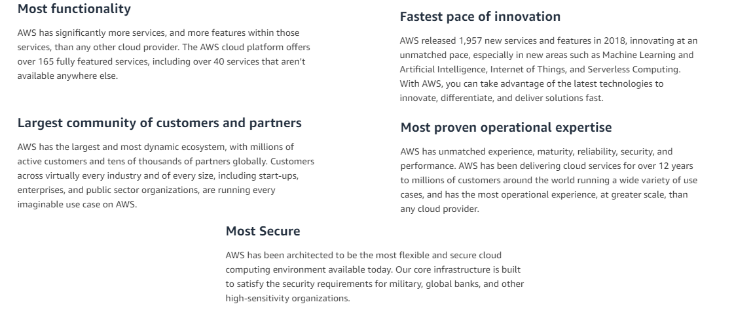
Amazon Web Service(AWS)

Slide 21
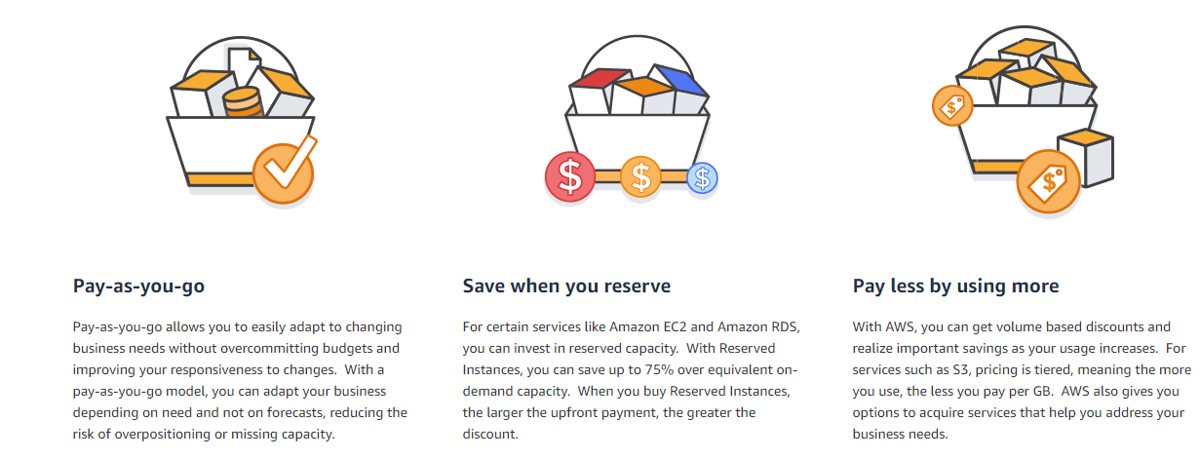
AWS Pricing

Slide 22
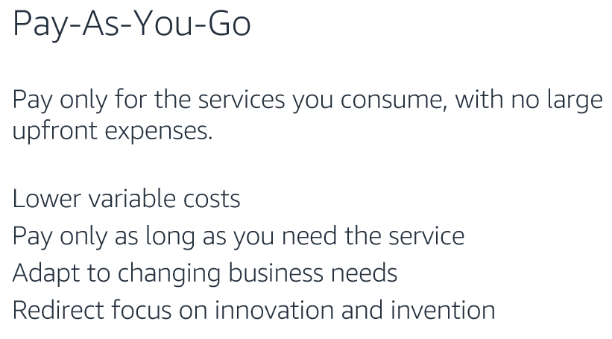
AWS Pricing

Slide 23
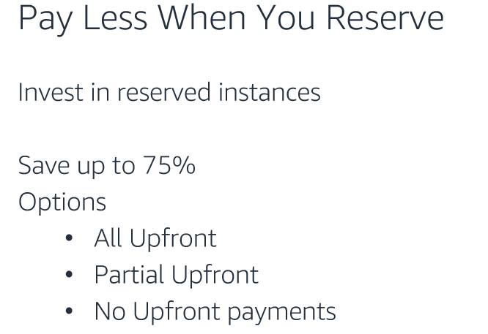
AWS Pricing

Slide 24
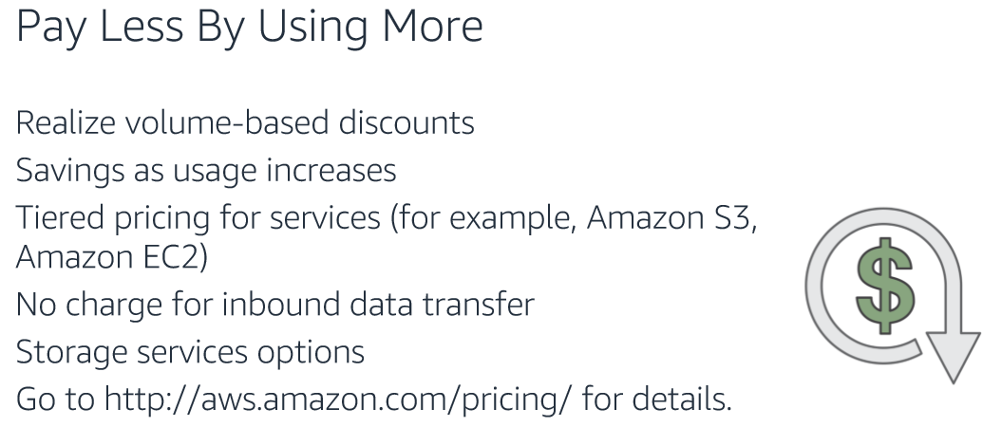
AWS Pricing

Slide 25
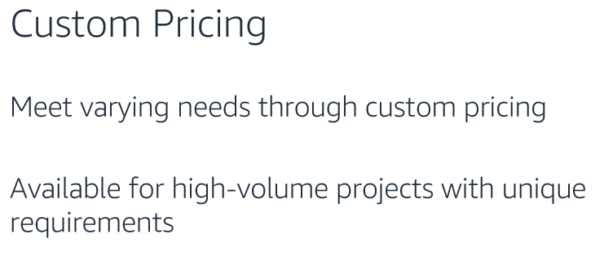
AWS Pricing

Slide 26
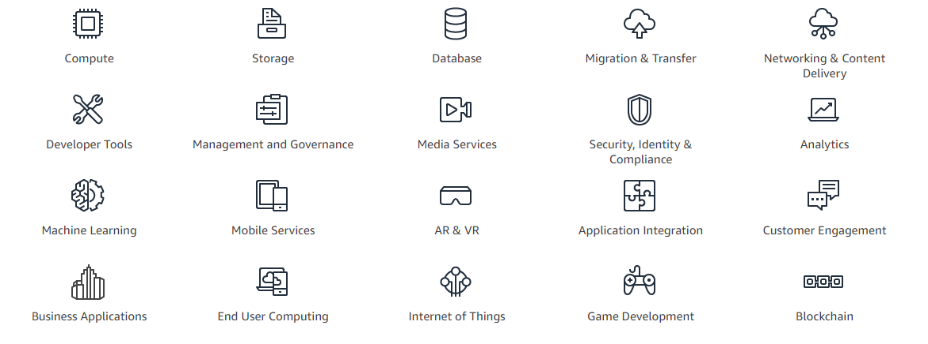
Important Amazon Services

Slide 27
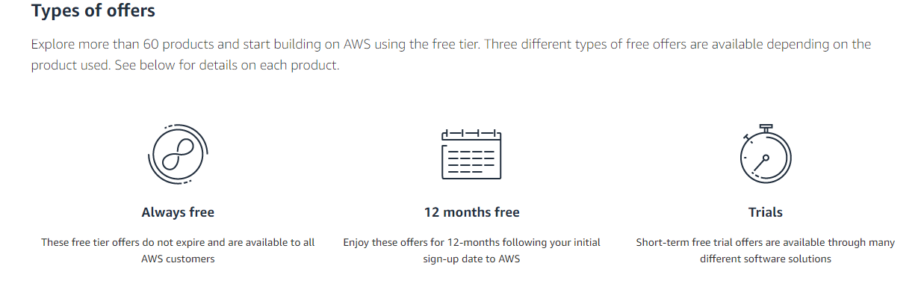
Amazon Free Tier

Slide 28
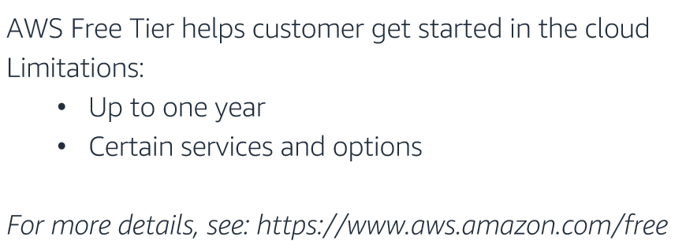
Amazon Free Tier

Slide 29
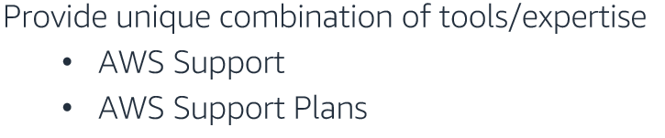

AWS Supports

Slide 30
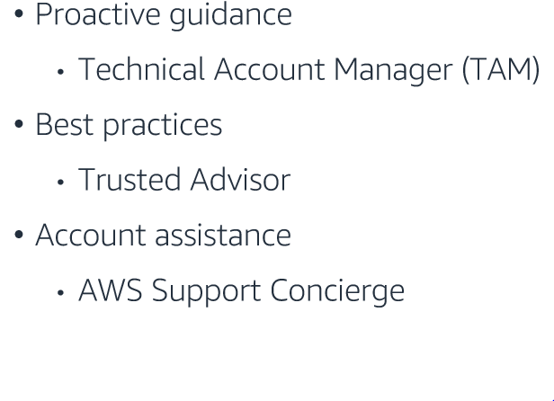
AWS Supports

Slide 31
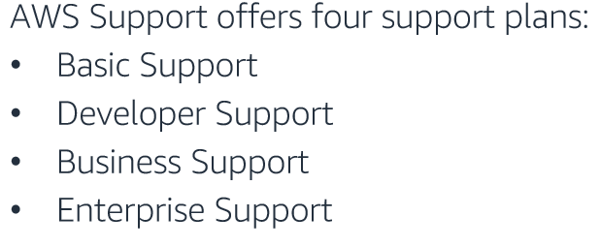

AWS Support Plans

